Slide 1
Computer Simulation
Module 2: Calculus, Probability, and Statistics Primers
Dave Goldsman, Ph.D.
Professor
Stewart School of Industrial and Systems Engineering
Covariance and Correlation

Slide 2
Lesson Overview
Last Time: We kicked butt on conditional expectation and its applications.
This Time: We’ll talk about independence, covariance, correlation, and related results.
Correlation shows up all over the place in simulation.

Slide 3
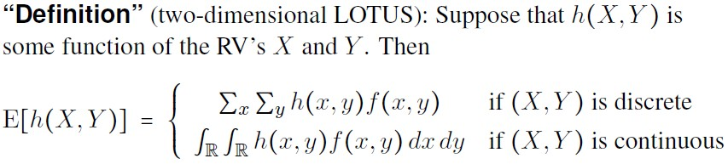




Slide 4
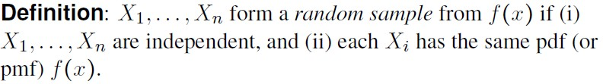
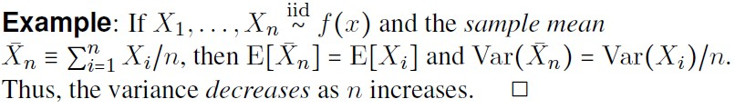

Slide 5
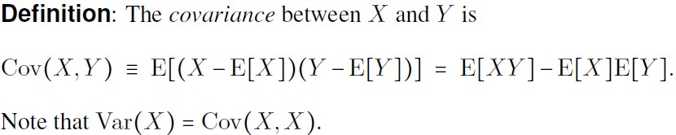
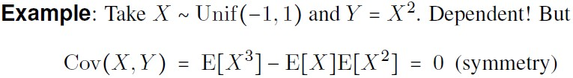

Slide 6
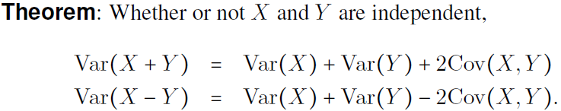
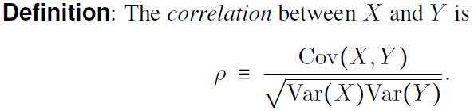


Slide 7
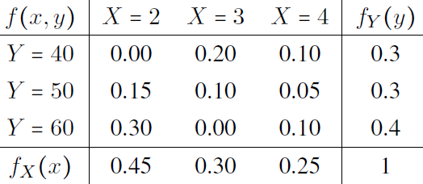





Slide 8
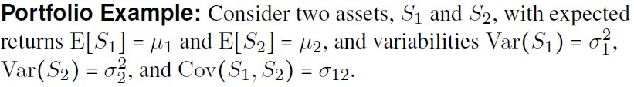
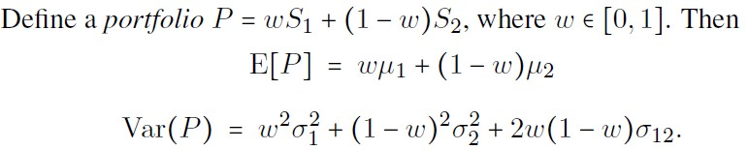
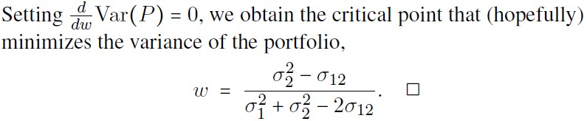

Slide 9



Slide 10
Summary
Defined covariance and correlation and gave a couple of practical examples.
Next Time: Quickie review of some favorite distributions.
Poisson arrivals are just around the corner!

Slide 11
Computer Simulation
Module 2: Calculus, Probability, and Statistics Primers
Dave Goldsman, Ph.D.
Professor
Stewart School of Industrial and Systems Engineering
Probability Distributions

Slide 12
Lesson Overview
Last Time: Defined covariance and correlation and gave a couple of practical examples.
This Time: These are a few of my favorite distributions.
We’ll go through a little list of important distributions, both discrete and continuous.

Slide 13
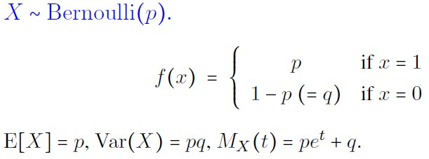
Notes:
Coin toss

Slide 14
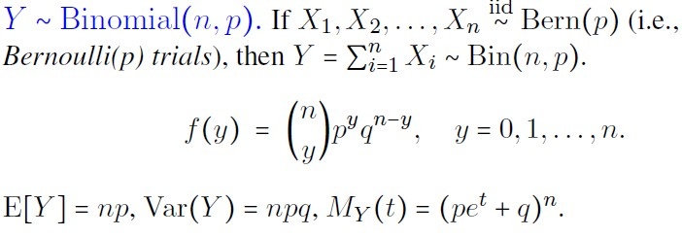
Notes:
The binomial is ‘n’ Bernoulli trials with probability q. Y is the number of successes and therefore between 0 and n.

Slide 15
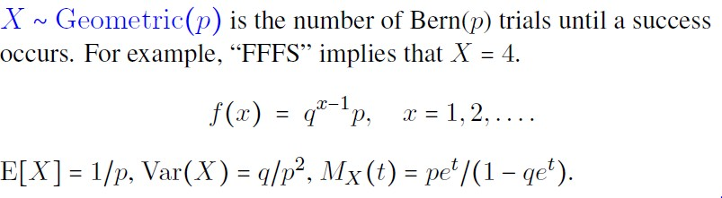
Notes:
This is the number of Bernoulli (coin tosses) until a success ours. X = 4 means you did 4 times before you got your first success. X in all.

Slide 16
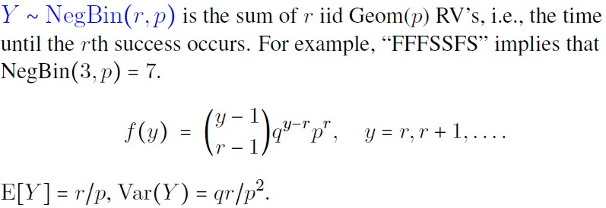
Notes:
How many trials until the “r-th” success

Slide 17

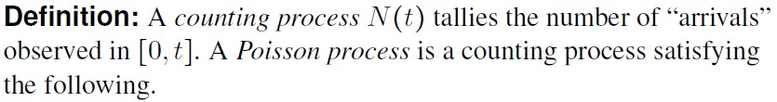


Slide 18
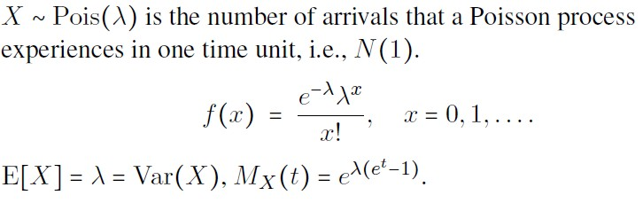
Notes:
X is the number of occurrences – and lambda is the poison distribution.

Slide 19




Slide 20
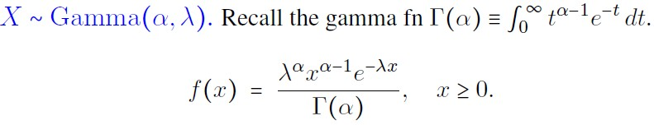
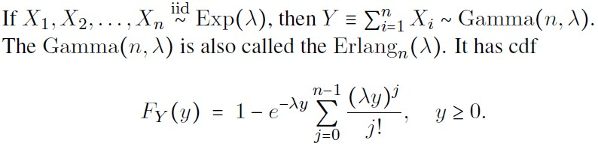

Slide 21
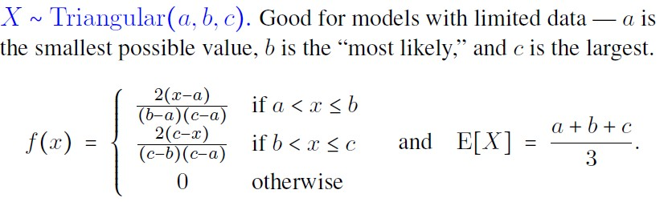
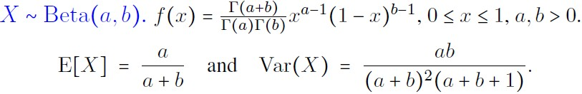

Slide 22
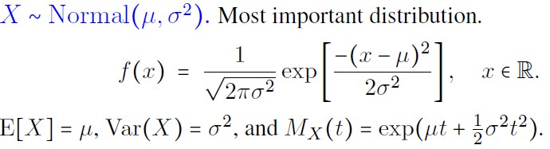
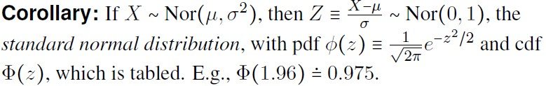

Slide 24
Summary
Went over our favorite discrete and continuous distributions.
Ended on a high note by ringing the bell with the normal.
Next Time: The normal figures prominently in The Law of Large Numbers and The Central Limit Theorem.
They’re not just good ideas – They’re the law!

Slide 25
Computer Simulation
Module 2: Calculus, Probability, and Statistics Primers
Dave Goldsman, Ph.D.
Professor
Stewart School of Industrial and Systems Engineering
Limit Theorems

Slide 26
Lesson Overview
Last Time: Went over a dictionary of distributions.
This Time: Take it to the limit one more time! What happens when the sample size gets big?
Normality happens! The Central Limit Theorem is the most- important result ever!

Slide 27
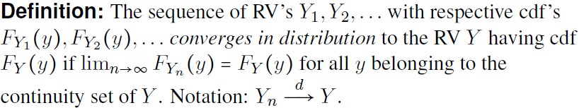

Notes:
X-bar’s variance gets smaller with more “n” which is good, because it means overtime this mean gets more and more definite as variance gets smaller.

Slide 28
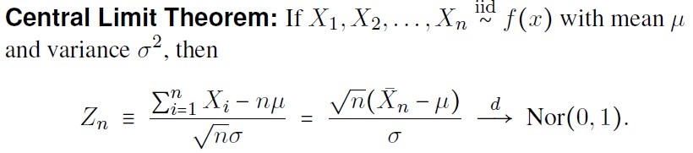

Slide 29
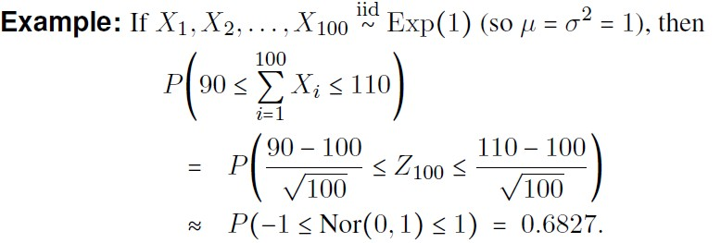
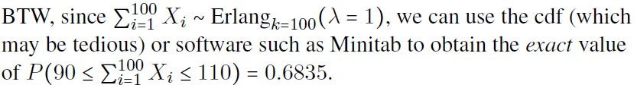

Slide 30



Slide 31
Summary
Went over some limit theorem results and applications.
Next Time: Stats Attack! We’ll be starting our Statistics Primer.

Slide 32
Computer Simulation
Module 2: Calculus, Probability, and Statistics Primers
Dave Goldsman, Ph.D.
Professor
Stewart School of Industrial and Systems Engineering
Introduction to Estimation

Slide 33
Lesson Overview
Last Time: We completed our Probability Boot Camp!
This Time: We’ll start our review of Statistics with some basics, including unbiased estimation and mean squared error.
If you are not yet (or no longer) a stats maven, simply go through the notes at your leisure.

Slide 34
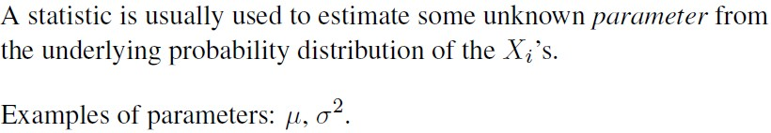
Notes:
You can use sample statistics to estimate the true value

Slide 35
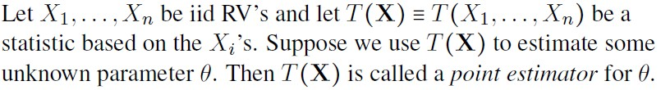


Slide 36
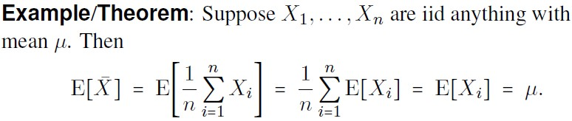

Slide 37
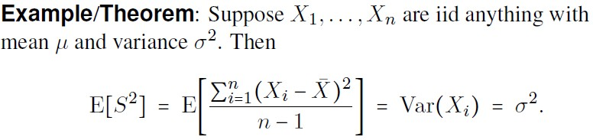

Slide 38
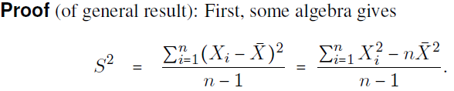
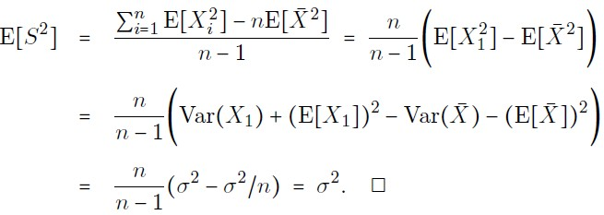

Slide 39


Slide 40


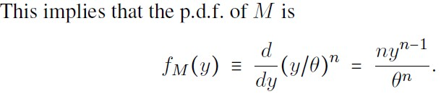
Notes:
Logically – the maximum of the Xi’s means all the X’s are less than y and because they are iid, that is just the product of all of them or just one of them. You can then calculate the individual probability which turns out ot be y/theta. The derivative of the cdf (big F(y)) is of course the pdf. And once you have the pdf you can calculate the expected value.

Slide 41
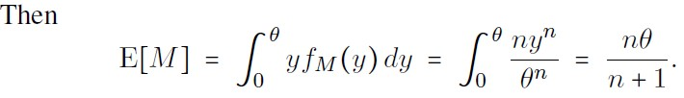
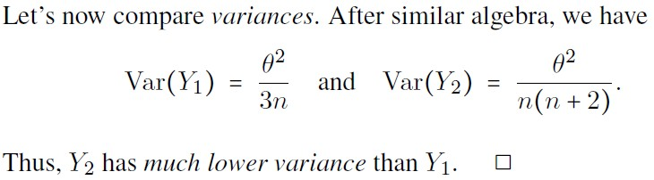

Slide 42
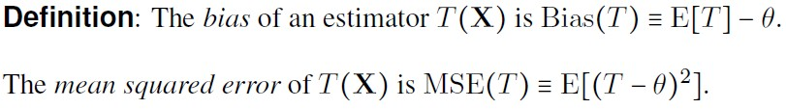
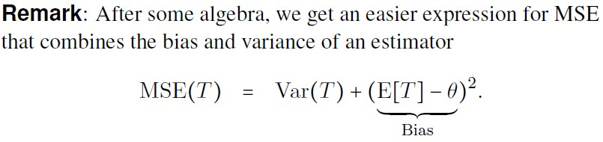

Slide 43

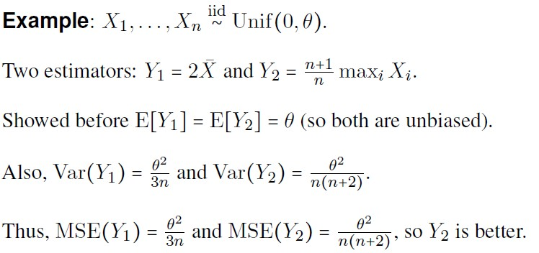

Slide 44
Summary
We began our Stats Attack with an intro to point estimation, including unbiasedness and MSE.
Next Time: We’ll study maximum likelihood point estimators, which are often quite flexible, even if they’re occasionally a teensy biased.

Slide 45
Computer Simulation
Module 2: Calculus, Probability, and Statistics Primers
Dave Goldsman, Ph.D.
Professor
Stewart School of Industrial and Systems Engineering
Maximum Likelihood Estimation

Slide 46
Lesson Overview
Last Time: Started our Stats Bootcamp with review of unbiased estimators and MSE.
This Time: Maximum likelihood estimation – perhaps the most popular point estimation method.
Very flexible technique that many software packages use to help estimate distributions.

Slide 47
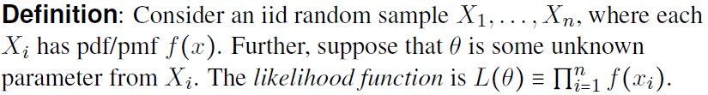
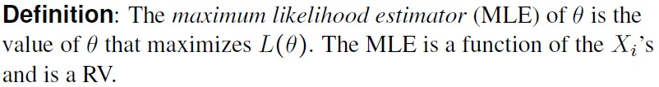

Slide 48
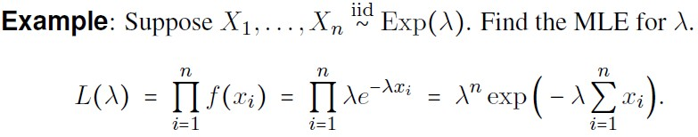
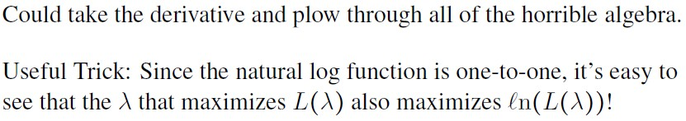

Slide 49


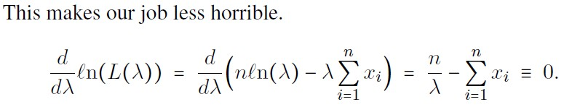

Slide 50


Slide 51
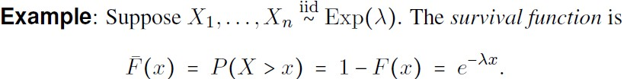
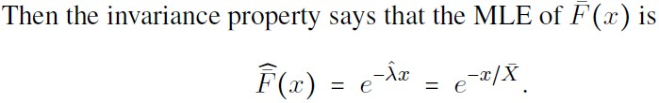

Slide 52
Summary
Went over some basics on Maximum Likelihood Estimators. These will be useful later in the course, e.g., when we do simulation input analysis.
Next Time: Point estimators are fine, but we can do better. The next lesson will deal with confidence intervals. I’m confident that you’ll enjoy it.

Slide 53
Computer Simulation
Module 2: Calculus, Probability, and Statistics Primers
Dave Goldsman, Ph.D.
Professor
Stewart School of Industrial and Systems Engineering
Confidence Intervals

Slide 54
Lesson Overview
Last Time: Reviewed maximum likelihood estimation for an unknown parameter θ.
This Time: we’ll do even better now… confidence intervals for θ!
We’ll use CIs throughout the course, especially when we do output analysis.

Slide 55
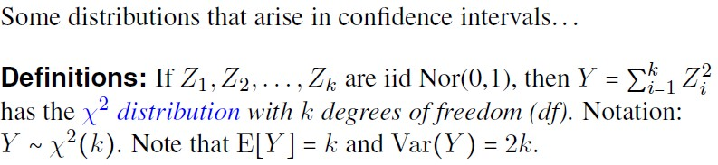
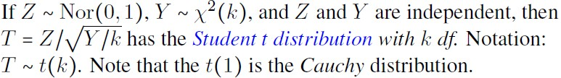
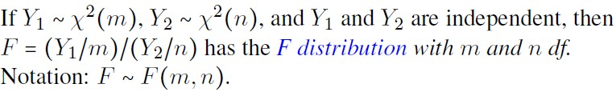

Slide 56
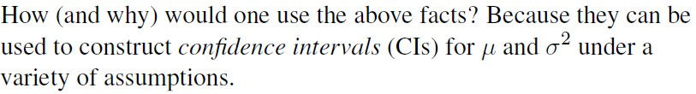

Slide 57


Slide 58


Slide 59


Slide 60


Slide 61



Slide 62
Summary
Reviewed a few CIs for the mean and variance of a normal distribution. More coming up later when we need them.
This completes Module 2, where we went to Calc, Prob, and Stats Bootcamps, sneaking in some simulation here and there.
Module 3 concerns hand and spreadsheet simulations.

